Slide 1
Update from education committee
Train the trainer—content reviewed from
Blood Pressure Management in Acute Stroke
“First Tuesdays” Lecture Series

Slide 2
Introduction and Goal of “First Tuesdays”
Sabreena Slavin MD – Vascular Neurologist and Neurohospitalist at KU School of Medicine
Craig Bloom RN, BSN, MBA – Senior Clinical Specialist Lytics, Genentech, Inc.
Didactic lecture series as part of the Kansas Initiative for Stroke Survival
Updates in Practice and FAQ’s on Acute Stroke Care
20 minute didactic, 10 minutes for questions/discussion

Slide 3
BP after stroke
Elevated systemic BP occurs in 3/4 of patients after acute stroke.
impairment of cerebral autoregulation
edema ---> intracranial hypertension
neuro-endocrine response from stress
Georgianou et al, J Human Hypertension 2018

Slide 4
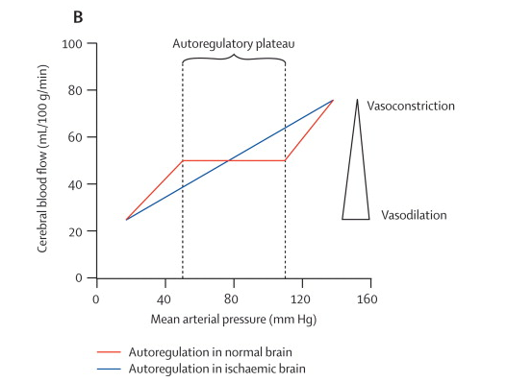
Tikhonoff et al, Lancet 2009

Slide 5
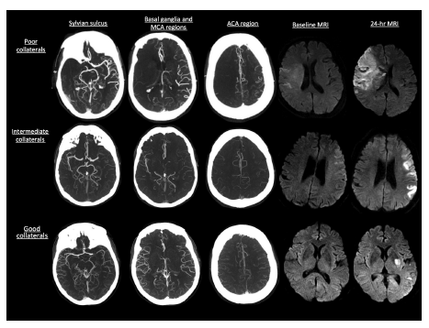
Nambiar et al, Brain 2013

Slide 6
Evidence for BP in ischemic stroke
Majority of RCT’s in acute ischemic stroke shows either harm or no benefit associated with BP lowering in the first 24 hours.
Data from IMWEST in 2000: acute ischemic stroke patients received Nimodipine vs placebo for 5 days, starting within 24 hours post stroke. Lower diastolic BP by ≥ 20% was associated with higher risk of death/dependency at 21 days:
(OR 10.16, 95% CI 1.02-100.74)
Ahmed et al, Stroke 2000

Slide 7
AHA/ASA Guidelines
In early post-stroke period, do not treat unless
BP greater than 220/120
BP greater than 200/110 + evidence of acute end-organ damage (AKI, aortic dissection, MI, hypertensive encephalopathy, acute pulmonary edema)
BP greater than 185/110 and eligible for tPA
No RCT’s studies have addressed treatment of low BP. General guidelines are to avoid hypoperfusion.
Powers et al, Stroke 2018

Slide 8
BP management after treatment
After tPA:
Do not treat unless BP greater than 180/105
After successful mechanical thrombectomy:
Do not treat unless BP greater than 160/90
Study shows that achieving lower than this BP within the first 24 hours after successful MT had a lower likelihood of 3 month mortality (OR 0.08, 95% CI 0.01-0.54)
Powers et al, Stroke 2018; Goyal et al, Neurology 2017
Notes:
A 10 mm Hg increment in maximum SBP documented during the first 24 hours post MT was independently (p = 0.001) associated with a lower likelihood of 3-month functional independence (odds ratio [OR] 0.70; 95% confidence interval [CI] 0.56-0.87) and a higher odds of 3-month mortality (OR 1.49; 95% CI 1.18-1.88) after adjusting for potential confounders

Slide 9
What about in ICH?
INTERACT2 (allowed various agents based on practitioner/institution choice)
2829 patients with mild-moderate ICH showed early intensive lowering of SBP less than 140 (vs less than 180) showed trend of reduced risk of death/major disability at 3 months (OR 0.87, CI 95% 0.75-1.01)
Secondary analysis showed improved mRS and better physical/mental health related QOL on EQ-5D scale.
ATACH-II (used Nicardipine only)
1000 patients did not show any benefits of intensive BP lowering.
Anderson et al, NEJM 2013; Qureshi et al, NEJM 2016

Slide 10
AHA/ASA Guidelines
In ICH, if SBP between 150-220, lowering SBP to 140 is safe (Class I, LOE A) and can improve functional outcome (Class II, LOE B)
In ICH, if SBP > 220, can consider aggressive reduction of BP with IV infusion (Class IIb, LOE C)
Hemphill et al, Stroke 2015

Slide 11
BP management if you don’t know
Meta-analysis of all stroke (ischemic or hemorrhagic) types also show either harm or no benefit:
Meta-analysis of 17 RCT’s showed controlling BP in acute stroke was associated with 34% higher risk of death within 30 days of stroke (RR 1.34, 95% CI 1.02-1.74).
Cochrane meta-analysis of 26 RCT’s showed acute BP lowering caused no difference in lowering death/dependency.
Consistent lack of benefit despite stroke subtype (ischemic vs hemorrhagic)
Wang et al, PLoS ONE 2014; Bath & Krishnan, Cochrane Database Syst Rev 2014

Slide 12
Hyperacute (EMS) treatment?
There was a subgroup analysis in the Cochrane meta-analysis:
BP therapy in those who presented within 6 hours of stroke (both ischemic and hemorrhagic) onset, there was a significant lowering in risk of death/disability (OR 0.86, 95% CI 0.76-0.99).
Bath & Krishnan, Cochrane Database Syst Rev 2014.

Slide 13
In the pipeline…RIGHT-2 Study
Rapid intervention with glyceryl trinitrate in hypertensive stroke trial-2 conducting in the UK
Subjects with acute stroke within 4 hours and SBP ≥ 120
Randomized to GTN patches vs placebo patches for 4 days
Primary outcome is death/poor mRS at 90 days
http://www.isrctn.com/ISRCTN26986053

Slide 14
Questions?
Call for help anytime!
KU BAT phone: 913-588-3727
http://www.kissnetwork.us/
sslavin2@kumc.edu

Slide 15
AHA/ASA Guidelines
In early post-stroke period, do not treat unless
BP greater than 220/120
BP greater than 200/110 + evidence of acute end-organ damage (AKI, aortic dissection, MI, hypertensive encephalopathy, acute pulmonary edema)
BP greater than 185/110 and eligible for tPA
No RCT’s studies have addressed treatment of low BP. General guidelines are to avoid hypoperfusion.
Powers et al, Stroke 2018

