Slide 1
Update from education committee
Train the trainer—content reviewed from
Transient Ischemic Attack
“First Tuesdays” Lecture Series

Slide 2
Introduction and Goal of “First Tuesdays”
Sabreena Slavin MD – Vascular Neurologist and Neurohospitalist at KU School of Medicine
Craig Bloom RN, BSN, MBA – Senior Clinical Specialist Lytics, Genentech, Inc.
Didactic lecture series as part of the Kansas Initiative for Stroke Survival
Updates in Practice and FAQ’s on Acute Stroke Care
20 minute didactic, 10 minutes for questions/discussion.

Slide 3
Review of Acute Stroke Interventions
IV alteplase (tPA) for all patients who have disabling symptoms of acute stroke
Mechanical thrombectomy: only for large vessel occlusions (LVO). Only hospitals with capabilities (eg: comprehensive stroke center) can perform thrombectomy.
A higher NIHSS (10 or more) can be indicative of a large vessel occlusion.
Diagnosed with CTA head/neck

Slide 4
Definition of TIA
Classical definition: Neurological symptoms attributable to ischemia that last less than 24 hours in duration.
Newer definition: Neurological symptoms attributable ischemia without evidence of ischemia in imaging or pathology
Sacco et al, Stroke 2013

Slide 5
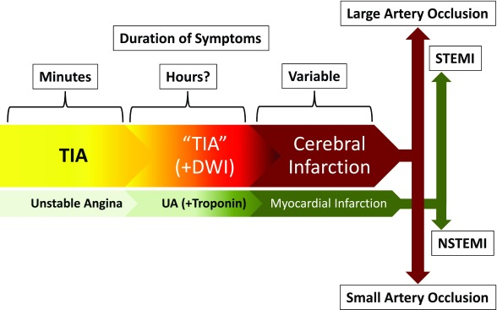
Gomez et al, F1000Research 2017

Slide 6
Stroke risk after TIA
Patients with either a mild stroke (NIHSS of 3 or less) or a TIA have a risk of recurrent stroke of 18% in the first 90 days.
Can classify further based on ABCD2 scoring system.
Coull et al, BMJ 2004

Slide 7
ABCD2
Age ≥ 60 = 1 point
Blood pressure ≥ 140 systolic OR ≥ 90 diastolic = 1 point
Clinical symptoms
Unilateral weakness = 2 points
Speech disturbance = 1 point
Diabetes = 1 point
Duration
Lasting ≥ 60 minutes = 2 points
Lasting 10-59 minutes = 1 point
Johnston et al, Lancet 2007

Slide 8
Scoring of ABCD2
High risk: 6-7 = 8.1% 2 day risk and 17.8% 90 day risk
Moderate risk: 4-5 = 4.1% 2 day risk and 9.8% 90 day risk
Low risk: 0-3: 1% 2 day risk and 3.1% 90 day risk

Slide 9
Newer improvements to ABCD2 scoring
ABCD3-I scoring:
Dual TIA’s (a preceding TIA within 7 days of current TIA) = 2 points
Carotid imaging with ≥ 50% stenosis on carotid artery responsible for symptoms = 2 points
MRI imaging showing a DWI-positive lesion = 2 points
Merwick et al, Lancet 2010

Slide 10
ABCD3-I scoring
Score of 1-3: 1% 90 day stroke risk
Score of 4-7: 2% 90 day stroke risk
Score of 8-13: 8% 90 day stroke risk
Merwick et al, Lancet 2010

Slide 11
Limitations of scoring systems
A significant proportion of patients classified into “low-risk” will still have recurrent strokes
Does not take into account other medical issues such as new-onset atrial fibrillation, hypercoagulability, etc.
Conversely, does not take into account potential stroke mimics

Slide 12
Location of TIA workup
Ambulatory setting favors cost-effectiveness
In-hospital setting favors expediency of care, patient safety, better outcomes
Other options are 24-hour hospital observation and expediated appointments in a specialized “TIA-clinic”
Gomez et al, F1000Research 2017

Slide 13
Workup for TIA
CT brain without contrast and MRI brain without contrast
Non-invasive vessel imaging: ideally CTA head and neck and MRI head and neck
Telemetry while in ED and hospital
Lab workup: lipid panel and HbA1c
Transthoracic echocardiogram – may consider as outpt if low risk and rapid follow-up available
24 hour observation – may consider truncating if low risk and rapid follow-up available

Slide 14
Bottom Line
TIA’s are now defined as any transient stroke-like symptoms without evidence of stroke on brain imaging
Scoring systems including MRI and vessel imaging can help to stratify risk
Majority of patients should have all their workup completed before discharge. May consider completing expediated outpt workup and follow-up for low-risk patients.

Slide 15
Questions?
Call for help anytime!
KU BAT phone: 913-588-3727
http://www.kissnetwork.us/
sslavin2@kumc.edu

