Slide 1
Article Review: Ideal Foundational Requirements for Stroke Program Development and Growth Scientific Statement from AHA
Sarah Langston, BSN, RN, CCRN-K, SCRN
Notes:
Good Afternoon. My name is Sarah Langston and I’m the Stroke Outreach Coordinator at the University of Kansas Health System. For the next few months in First Tuesdays, we are going to be talking about new releases and updates from International Stroke Conference. This month, our focus is going to be a AHA Scientific Statement that was released at ISC to guide facilities to what foundational needs are helpful for Stroke Center Success.

Slide 2
Article published in 2023 and presented at ISC Feb 2023
Notes:
This Guideline was developed to be helpful to Stroke Centers. Although certifying bodies (including states) have outlined scope and standards for each level, there is little literature to guide hospitals. Because of the lack of standards, there is significant variation in practice and resources available.
This guideline will not only give a foundation to stroke centers, but it also may help provide some much needed evidence to back increasing stroke center resources---something a lot of us can use in our programs when influencing decision makers!

Slide 3
Polling Question #1
What level of Stroke Center do you work in?
A. Non-Emergent Stroke Ready or Missouri Level 4
B. Acute/Emergent Stroke Ready or Missouri Level 3
C. Primary Stroke Center or Missouri Level 2
D. Thrombectomy Capable Stroke Center
E. Comprehensive Stroke Center or Missouri Level 1
F. I don’t know
Notes:
I do have a few polling questions scattered through this presentation today. You will see a Zoom poll box pop up on your screen and you should use that to answer these polling questions. My hope is to make this more interactive for you as well as get to know what resources that you have!

Slide 4
Outline
Levels of Stroke Care
Program Leadership
Personnel Resources
Neuroimaging Capabilities
Procedural Capabilities
Hospital Bed Resources
Quality Improvement and Clinical Research
Notes:
We will begin talking about levels of stroke care, then move into program leadership, personnel resources, neuroimaging capabilities, procedural capabilities, hospital bed resources, and end with quality improvement and clinical research.

Slide 5
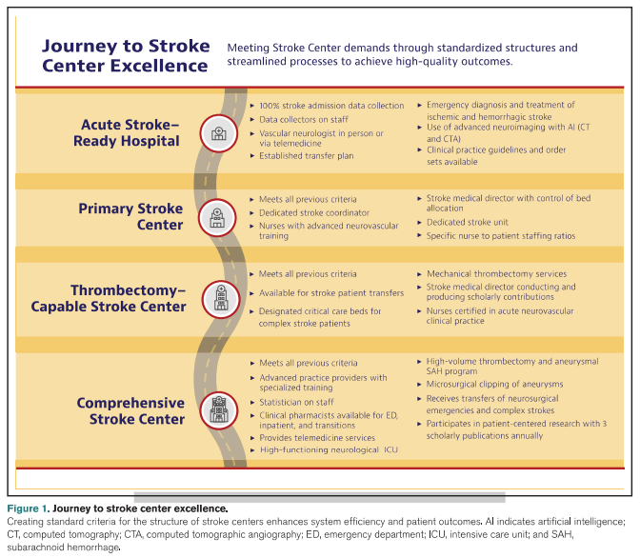
Notes:
This figure describes the various levels of CERTIFIED Stroke centers and the standard criteria for the structure of each center.

Slide 6
Stroke Program Leadership
Corporate Leadership (title varies)
Stroke Program Medical Director
Advanced Practice Providers
Stroke Coordinators
Notes:
There are 4 key leaders that are in each stroke program…
Chief Executive Officer should set strategic goals and initiatives for the organization and stroke program should be an important piece. Service line director or senior member of administration may also oversee neuroscience service. Titles and models may vary, but organizational charts should be created that clearly show the chain of command.
There are four categories of leaders that are mentioned in this article.
Stroke Program Medical Director should be knowledgeable to serve as the leader directing delivery of vascular neurology services. PSC, TSC, and CSCs should have this role filled. Should encourage Medical Director to have vascular neurology fellowship training or board certification; annual participation in regional, national, or international stroke conferences; and 8 CME hours of stroke annually. This role collaborates closely with the stroke coordinator to delineate program policies and procedures that standardize the process.
I’m going to mention the two roles of Advanced Practice Providers and Stroke Coordinator on the next slides.

Slide 7
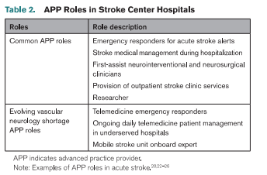
Advanced Practice Providers
May include Physician Assistants, Nurse Practitioners, and Clinical Nurse Specialists
Ideally should have completed postgraduate vascular neurology fellowship training with certification as advanced neurovascular practitioner
Educators
Responsibilities
Roles Vary
Notes:
This category of Advanced Practice Providers may include Physician Assistants, Nurse Practitioners, and clinical nurse specialists. Ideally, they should have completed a post graduate vascular neurology fellowship training with certifications as advanced neurovascular practitioner. This table shows how the role varies between the 4 levels of certifications.
These APPs are providers of informal and formal education and drive continuous improvement of interprofessional team practices. Responsibilities should include working to support performance improvement and research, partners to Stroke coordinator and medical director, help developing community and patient education; help with development of regional stroke systems and stroke legislative initiatives.
Official roles vary and this is shown in Table 2

Slide 8
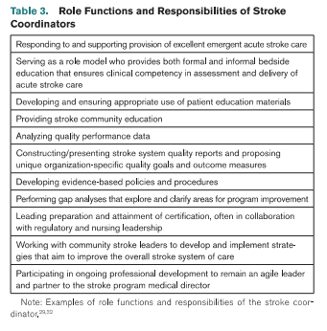
Stroke Coordinators
Notes:
Stroke Coordinators are empowered to access and optimize stroke services within their hospital. Historically, this role was developed by the research nurse to suppose the NINDS rt-PA Study in which these nurses ensured standardized emergency care response and monitoring of trial subjects.
Stroke coordinators are the leaders in stroke care, designing and implementing quality improvement programs that are supported by defined, measurable outcome targets. They use evidence-based care to target health outcomes. They must have expert acute stroke knowledge and skills to understand new evidence, gaps and in care, resources and services. Those in the role that lack clinical competence may focus entirely on administrative functions or data management, thereby failing to fully execute the stroke coordinator role.
Other specific responsibilities are located in this table.

Slide 9
Personnel Standards of the Stroke Program
Skilled Interprofessional Communication
True Collaboration
Effective Decision Making
Appropriate Staffing
Meaningful Recognition
Authentic Leadership
Notes:
Effective Stroke Care depends on the contributions of interprofessional clinicians who interact with patients. All stroke clinicians must take responsibility for a healthy work environment, working on 6 established standards:

Slide 10
Polling Question #2
Do pharmacists respond to your Acute Stroke Responses?
A. Yes
B. No

Slide 11
Personnel Resources to Improve Outcomes
Neurologists and Neurointerventionalists (including Telestroke)
Data Collection Staff
Pharmacists
Nurses
Fellow-ship trained preferred
No more than 500 patients annually/staff member
May respond to stroke alerts and/or round with Neurology team
Encourage certification and good RN to patient ratios
Notes:
Interprofessional clinicals are necessary to contribute to the team.
Vascular Neurologists, Neurointerventionalists and Telestroke Responders may be helpful parts of the team.
Fellowship trained Vascular Neurologists should support centers that perform mechanical thrombectomy and advanced endovascular or surgical procedures. These providers should complete at least 8 hours of related education annually.
Stroke centers performing thrombectomy and advanced endovascular procedures also require neurointerventionalists. Standard 2-year neurointerventional training with biplane angiography is the gold standard. The 2 main determinants of improved patient outcome are formal training and case volume.
Telestroke resources should also be used, as needed, for emergent stroke treatment.
Next, the category of data collection staff. These data collections should undergo formal training to become knowledgeable of data definitions and collection procedures. Data collector role should limit collection duties to no more than 500 patients with stroke annually.
Pharmacists enhance the team performance and may be used to respond to stroke alerts, expediting medication and reversal management, round with the Neurology team to provide medication expertise and patient/family teaching.
Lastly, nurses with expanded education and ability to use evidenced-based nursing care protocols have been shown to significantly improve patient outcomes at 3 months. Certification and board certifications are encouraged and at least 8 hours per year of education should be targeted. Staffing should be kept at 4:1 or less (Only DNV looks at this)

Slide 12
Polling Question #3
Do you have 24/7 available CT Angiography (CTA Head/Neck) at your facility?
A. Yes
B. No

Slide 13
Neuroimaging Capabilities
Notes:
CT Head should be done quickly as well as CT Angiography capabilities should be available 24/7 at PSC/TSC and CSC hospitals. Artificial Intelligence software should be used at all levels of care (RAPID, Viz AI).

Slide 14
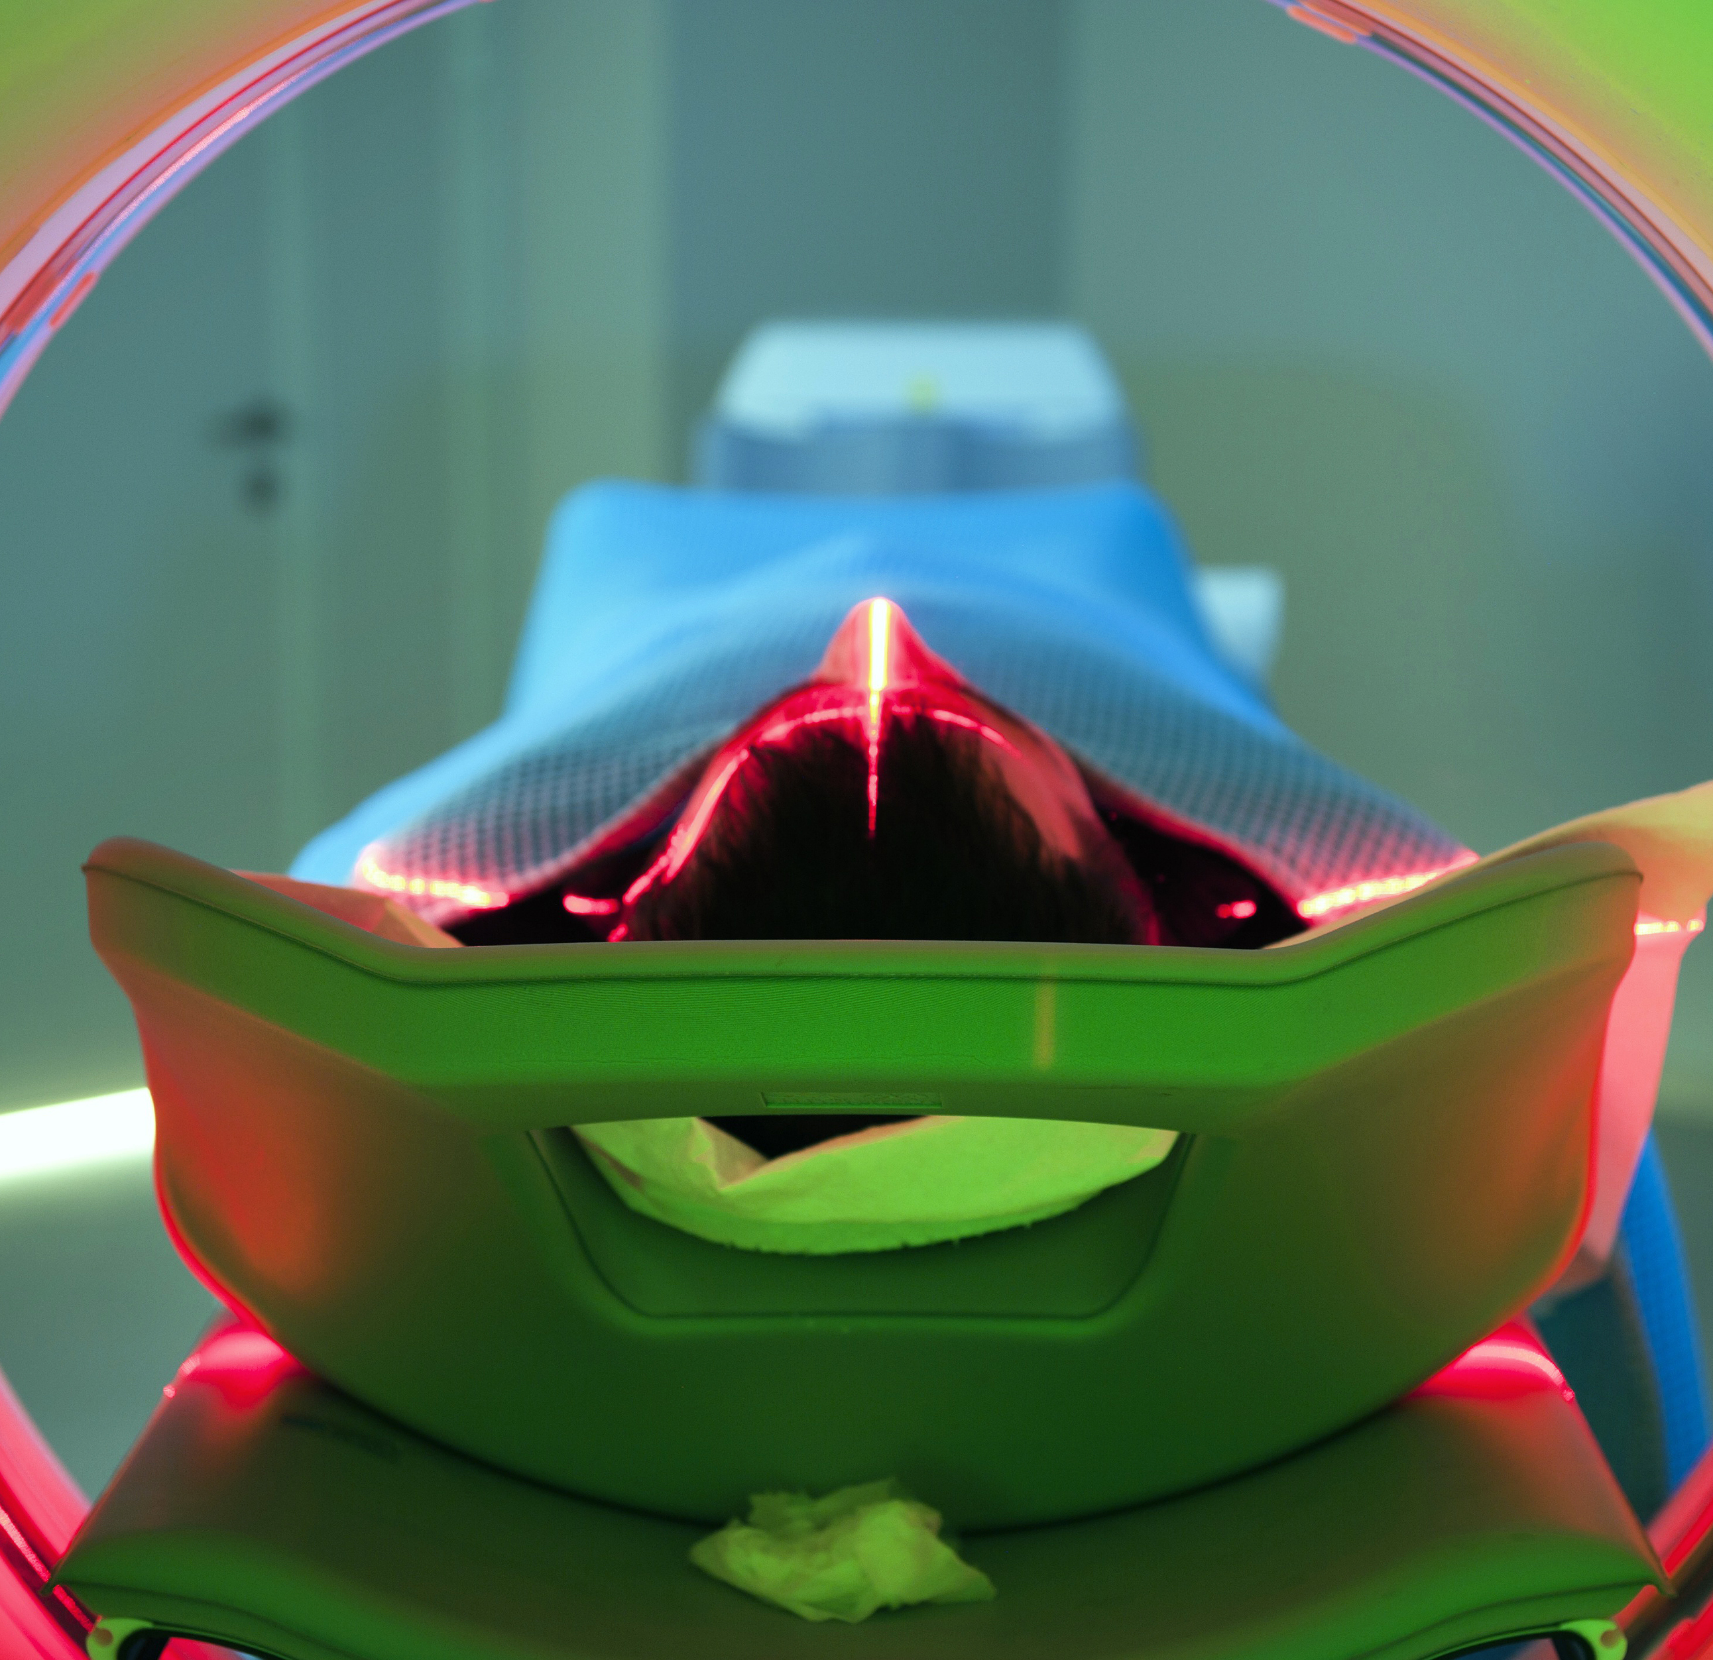
Procedural Capabilities
Emergency management of Hemorrhagic Stroke
BP management ability including continuous infusions
Antidotes for anticoagulation
Should be transferred to CSCs
Determination of stroke mechanism
Notes:
For the emergent management of ICH, continuous antihypertensive infusions and antidotes for anticoagulation should be available at all levels of care. This should be completed within 60-90 minutes of arrival to reduce the risk of hematoma expansion.
All stroke centers who admit patients should be able to determine stroke mechanism.

Slide 15
Polling Question #4
If you admit stroke patients to your facility, do you have a dedidated “Stroke Unit”?
A. Yes
B. No
C. We don’t admit stroke patients

Slide 16
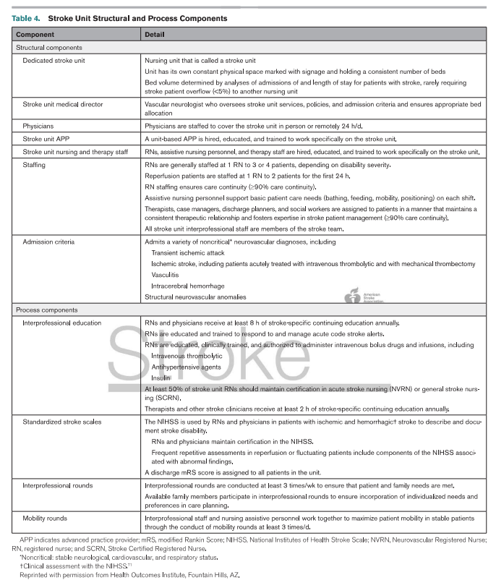
Hospital Bed Resources
Stroke Units and Transfer Resources
Notes:
AHA guidelines have recommended stroke units for over 20 years, but didn’t give guidance for what constitutes a stroke unit. This table describes components of what that unit structure should look like. I will highlight a few that I thought were extra helpful.
If patients are transferred to a higher level of care they should be done so quickly. Internal data should be gathered to guide improvement processes about transfer times

Slide 17
Quality Improvement and Clinical Research
Strive to collect data on 100% of cases
Must select a quality model to use for program improvement
Research is a CSC requirement and teams should strive for 3 scholarly works/year
Notes:
Quality improvement is essential to stroke program development and evolution. Teams should strive to collect data on 100% of stroke patients seen at your facility. For Quality Improvement, a consistent model should be used to analyze program performance. Quality improvement should be interprofessional. Mature programs should disseminate their work to assist others with performance improvement.
Regarding clinical research, this tends to be limited to Comprehensive Stroke Centers since this is a certification requirement for many programs. Stroke certification standards lack guidance on what is acceptable research endeavors. ..CSCs should make annual publication of 3 scholarly works per year. Research may include basic science, clinical research, and stroke systems of care.

Slide 18
Conclusion
Certified Stroke centers have been shown to positively affect stroke patient outcomes
This guideline will help reduce variability and strengthen stroke center services
Leaders must embrace service goals to stimulate growth to set the pace for the future

Slide 19
Reference
Dusenbury, W., Mathiesen, C., Whaley, M., Adeoye, O., Leslie-Mazwi, T., Williams, S., Valasco, C., Shah, S., Gonzales, N., Alexandrov, A. (2023). Ideal foundational requirements for stroke program development and growth: A scientific statement from the American Heart Association. Stroke, 54, https://doi.org/10.1161/STR.0000000000000424

